Slide 1
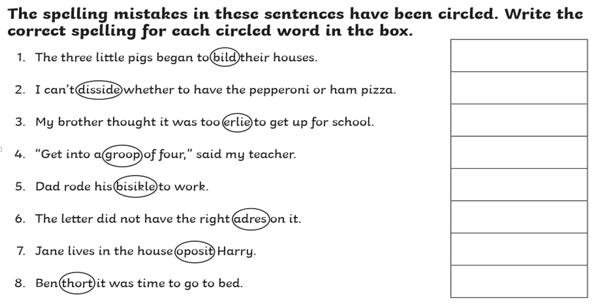
Correct the spelling!

Slide 2
