Slide 1
Diagnostic Questions (Maths)
On the following slides you will find a total of 10 Maths questions to have a go at.
Each question has 4 multiple choice answers to choose from; one of them is the correct answer.
Work out which answer you think is correct and write it down in your exercise book.
The correct answers will be given to you in next week’s Diagnostic Questions PowerPoint so you can mark your work.

Slide 2
WEEK 1 – 27/03/2020 – Count in multiples of 6,7,9
ANSWERS
1. A
2. C
3. C
4. D
5. C
6. B
7. D
8. A
9. B
10. D

Slide 3
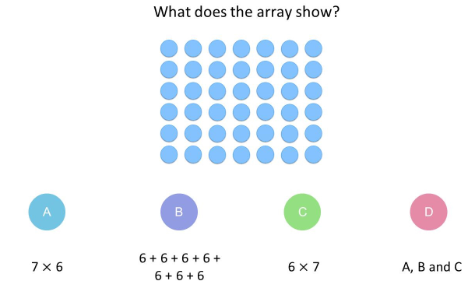
WEEK 2 – 03/04/2020 – Recall Multiplication facts up to 12x12
QUESTION 1

Slide 4
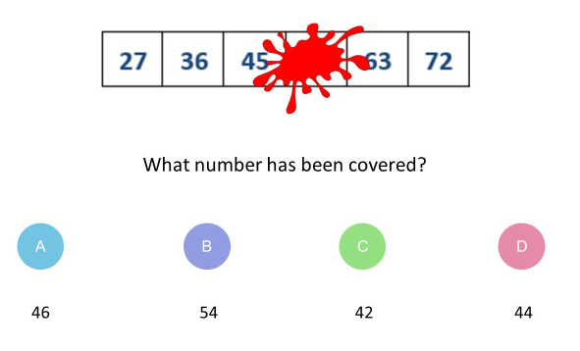
QUESTION 2

Slide 5
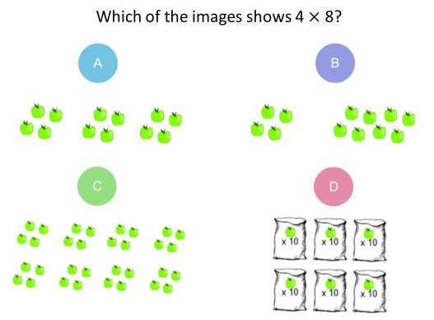
QUESTION 3

Slide 6
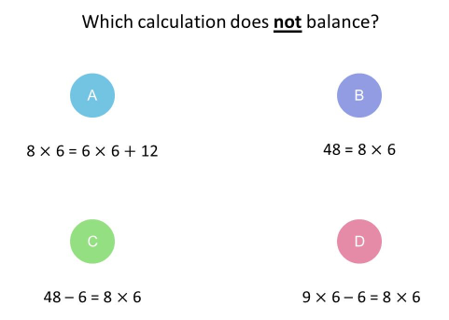
QUESTION 4

Slide 7
QUESTION 5

Slide 8
QUESTION 6

Slide 9
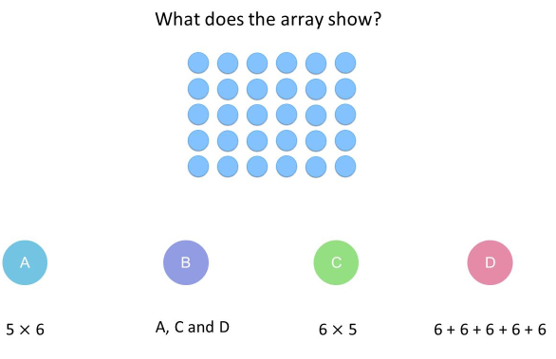
QUESTION 7

Slide 10
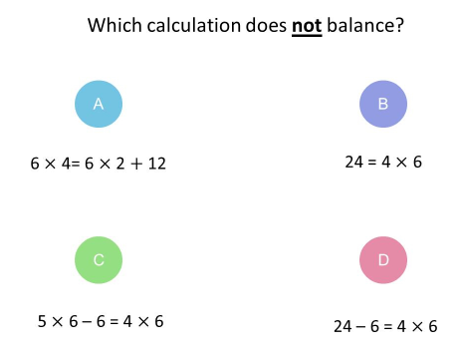
QUESTION 8

Slide 11
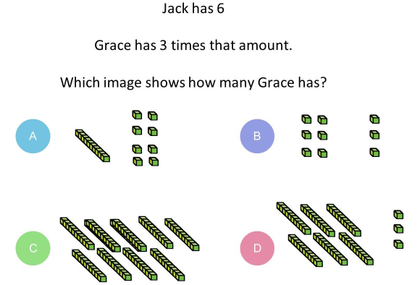
QUESTION 9

Slide 12
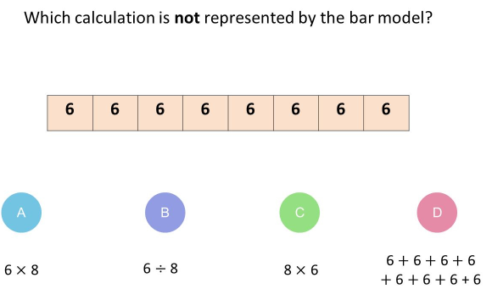
QUESTION 10

