Slide 1
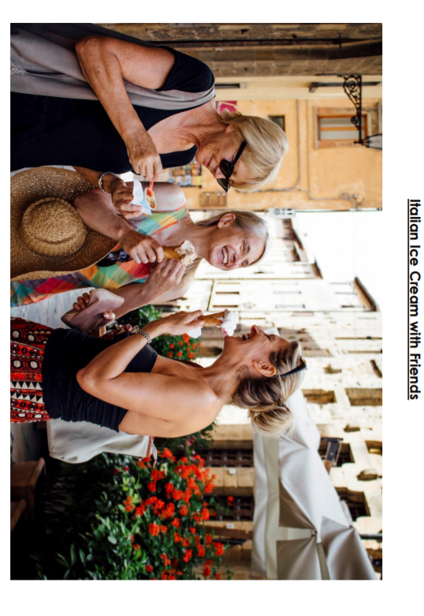
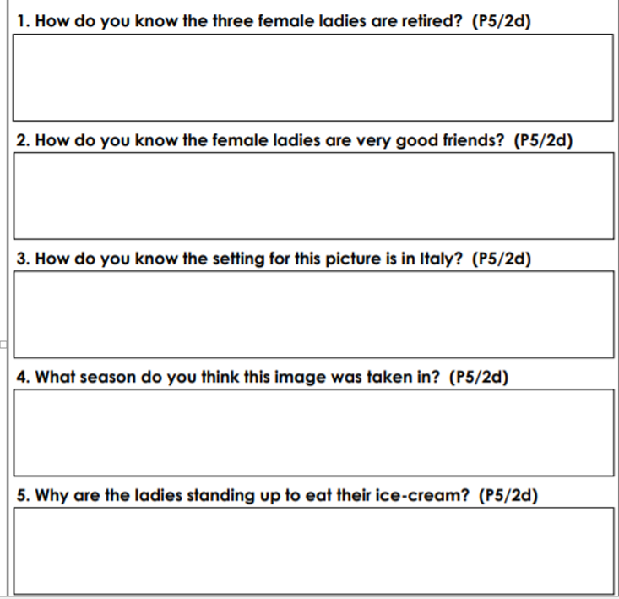

Slide 2
ANSWERS
The female ladies look as though they are retired because they are older in age.
The female ladies appear to be good friends because they are socialising with one another, and laughing and joking around.
The setting of the picture is in Italy because the buddings in the background are different to here in England. The streets have cobbling in them and the ladies seem to be on a holiday.
The season is summer because the ladies are eating ice-cream.
The ladies are standing up because there no seats nearby, they are standing outside the ice-cream shop, or they are in middle of a narrow shopping street.

Slide 4
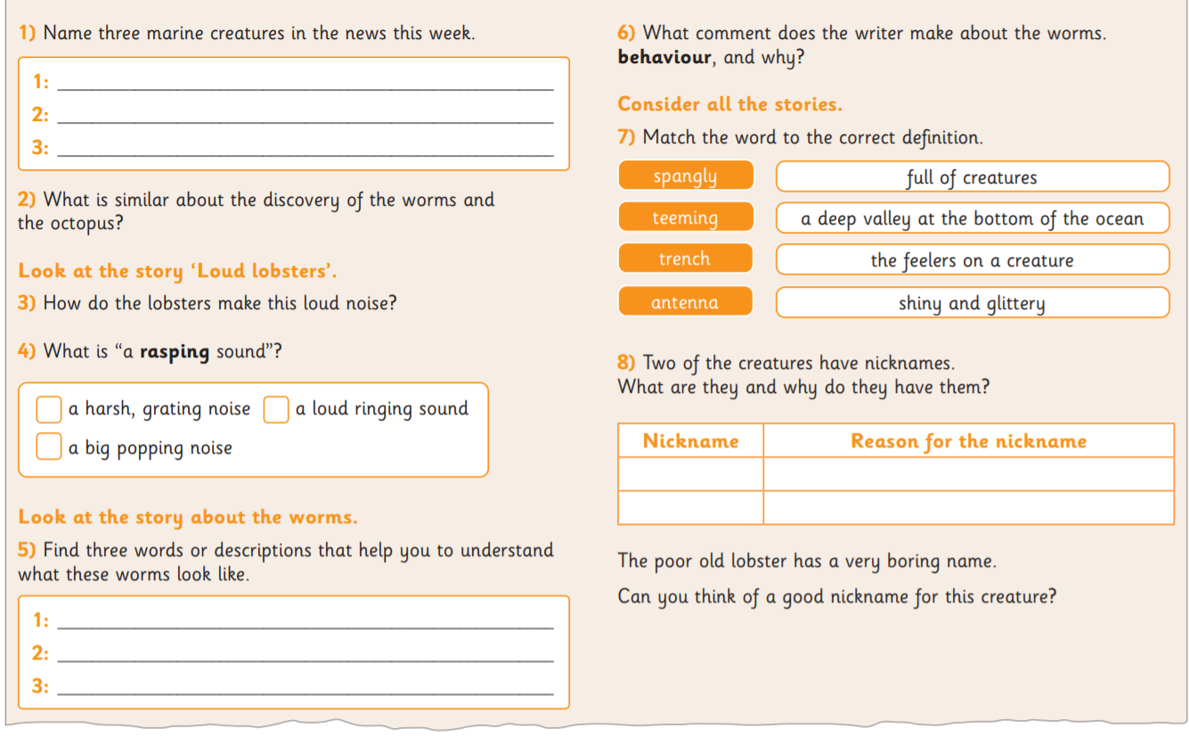
He says they are not so glamorous because they wiggle, fight and bite.
lobster
Octopus
worms
Both are found deep in the ocean.
By rubbing their antennas against a rough spot beneath their eyes.
X
Dumbo
Ear like fins look like elephant ears
Elvis Presley
Shiny scales look like sequins on Elvis’ suit.
glittery
glamorous
Answers may vary
spangly

Slide 6
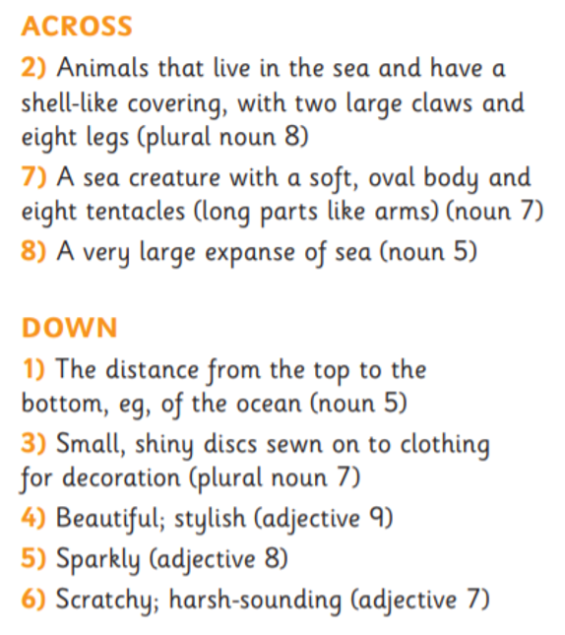
ANSWERS
ACROSS
2) lobsters
7) octopus
8) ocean
DOWN
1) depth
3) sequins
4) glamorous
5) glittery
6) rasping

