Slide 1
Have a read of these amazing animal shape poems. Look carefully at the poetic lines and how the poet has created the design in the shape of the animal….

Slide 2
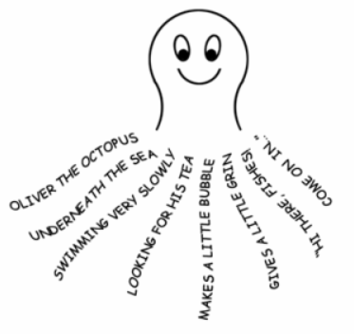

Slide 3
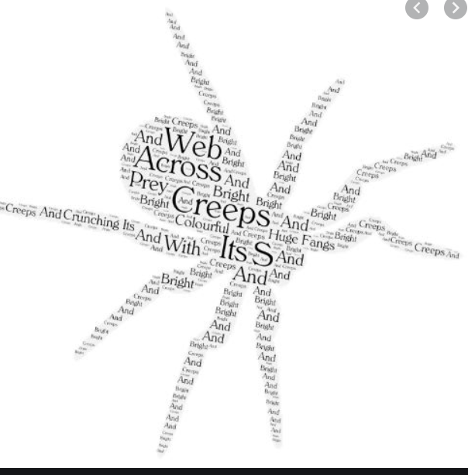

Slide 4
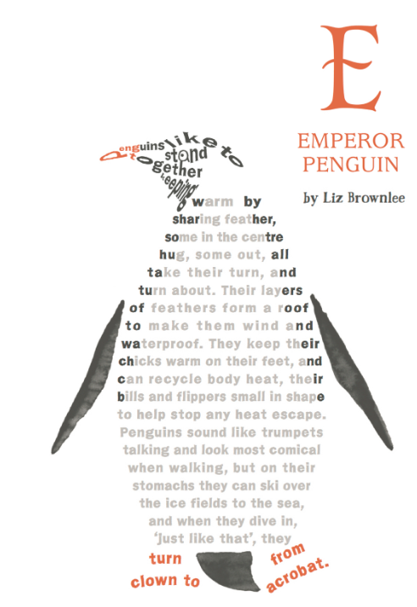

Slide 5
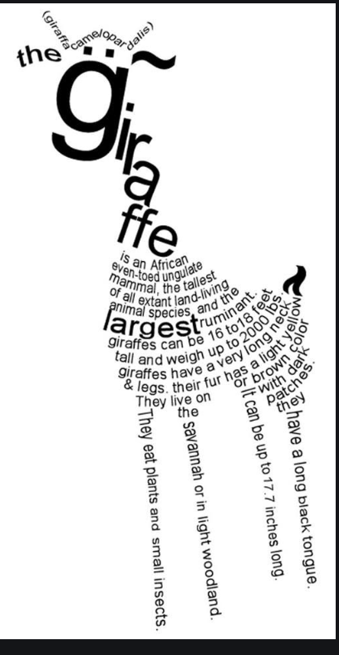

Slide 6
