Slide 1
Diagnostic Questions (Maths)
On the following slides you will find a total of 5 Maths questions to have a go at.
Each question has 4 multiple choice answers to choose from; one of them is the correct answer.
Work out which answer you think is correct and write it down in your exercise book.
The correct answers will be given to you at the end of the PowerPoint.

Slide 2
Answers to Last Week’s Questions
1. B
2. B
3. A
4. B
5. C

Slide 3
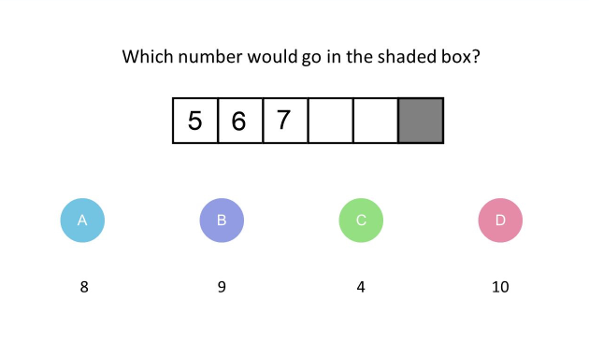
1.

Slide 4
2.

Slide 5
3.

Slide 6
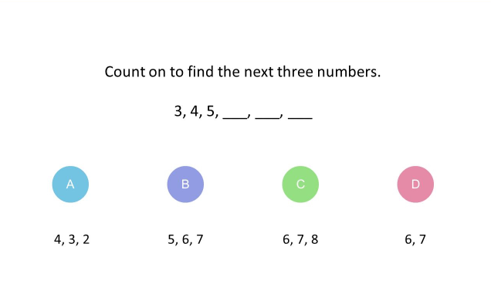
4.

Slide 7
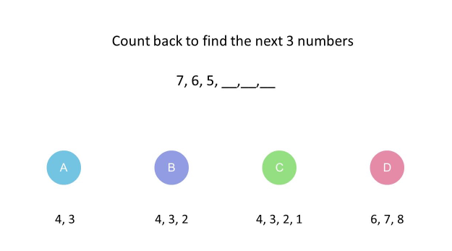
5.

Slide 8
Answers
1. D
2. A
3. D
4. C
5. B

